Slide 1
Eumetrain EW 2021
VALIDATION of H-SAF SNOW PRODUCTS
Alexander Toniazzo
Civil Protection Italy - Rome

Slide 2
H-SAF PT Meeting
SUMMARY
Snow Products in H-SAF
Validation results, performances and limitations
Discussion and questions

Slide 3
H-SAF PT Meeting
Snow Products in H-SAF
Legacy products over European area - operational
H10 Snow detection – Snow cover
H11 Snow status (wet/dry)
H12 Effective (Fractional) Snow Cover FSC
H13 Snow Water Equivalent SWE
Global and hemispherical products:
H34 and H35 new products (Snow det. and FSC) Pre-op
H31 and H32 ex L-Saf products (Snow det.) Op

Slide 4
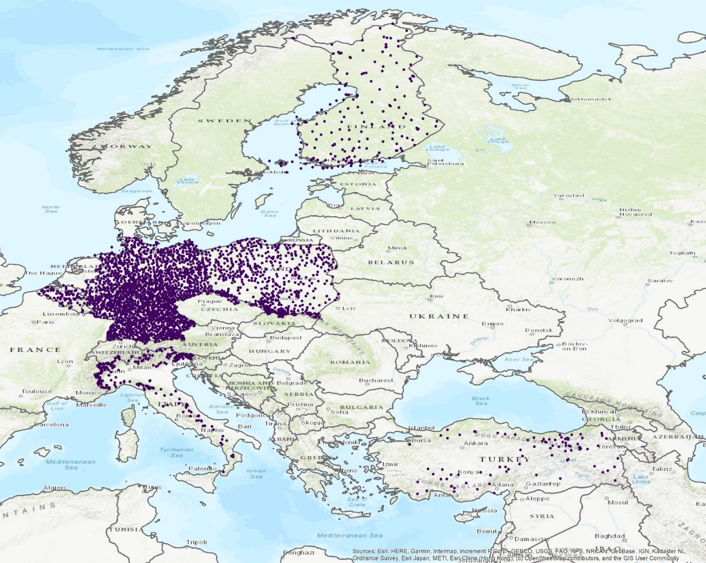
H-SAF PT Meeting
Ground Station Network
Weather stations
and snow detection: manual and automatic
SWE Stations
Country | Type | Number of Stations
Finland | Synoptic | 190
Turkey | Synoptic | 85
Italy | Snow/Avalanche | 264
Poland | Synoptic | 595
Germany | Synoptic | 1863
Belgium | Teleclim | 84
TOTAL |  | 3081

Slide 5
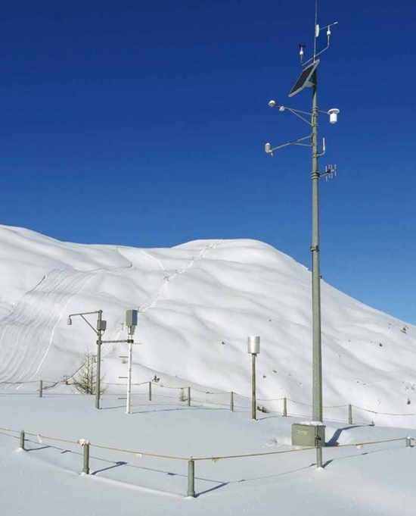
H-SAF PT Meeting
Ground Station Network
Weather stations: manual and automatic
In some countries WMO Weather Stations are used, in other counties dedicated Snow Station Networks provide the data for validation.
Snow field in the Italian Alps with an Automatic Snow and Meteorological Station

Slide 6
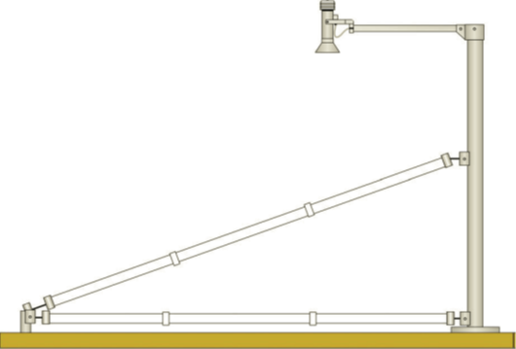
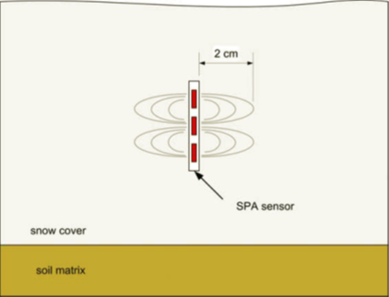
H-SAF PT Meeting
Ground Station Network
SWE Stations
For validating SWE high quality ground data is used.
Example of Ground Station in Turkey –
Snow Pack Analyser (SPA).
The complete SPA System consists of two (2) SPA sensing bands with one installed horizontally 10 cm above the ground and the other installed at an angle (referred to as the sloping band), an impedance analyzer, an ultra-sonic snow depth sensor and mounting accessories to assure proper tension of the SPA bands. Each of the SPA bands sends frequencies into the snow pack and measures the complex impedance. Snow consists of ice, air and water. Each of these elements have different dielectric constants and when the band sends out the measuring frequencies it is able to read the returned value to determine the percentage of liquid water, ice and the remaining value as air.

Slide 7
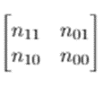
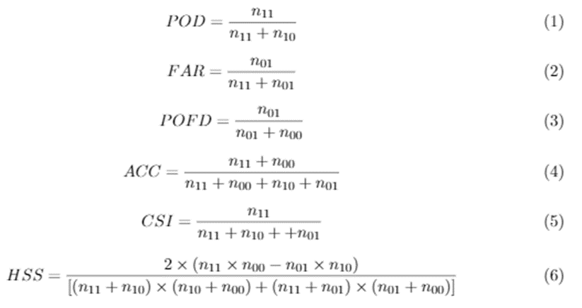
H-SAF PT Meeting
Validation – Snow detection
H10 (H31) H32 and H34:
Validation methodology - Confusion matrix:
Hits n11, False alarms n01
Misses n10, Correct negatives n00
POD
FAR

Slide 8
H-SAF PT Meeting
Validation results H10
H10 in OR10 snow season 2019-20:
POD slightly out of spec for Flat/Forest areas, but fully compliant for Mountainous areas. Problems arise in H10 if snow is scarse and snow cover is not homogeneous in space and time, as was in winter 2019/20 in central Europe.
Statistical scores for H10 over mountainous and flat areas period 1.10.2019-31.5.2020
H-SAF Accuracy requirements for H10 in Flat/Forest areas
Product requirements |  |  |  | H10
Score | threshold | target | optimal | total
POD | 0.80 | 0.85 | 0.99 | 0.74
FAR | 0.20 | 0.15 | 0.05 | 0.27
H-SAF Accuracy requirements for H10 in Mountainous areas
Product requirements |  |  |  | H10
Score | threshold | target | optimal | total
POD | 0.60 | 0.70 | 0.99 | 0.70
FAR | 0.30 | 0.20 | 0.05 | 0.22

Slide 9
H-SAF PT Meeting
Validation results H10
H10 in OR10 snow season 2019-20:
Validation has been performed over Belgium, Finland, Germany, Italy, Poland and Turkey.
The results are showed separately for flat and mountainous areas to provide complete error information on the product performances related to the orography.
Statistical scores for H10 over mountainous and flat areas period 1.10.2019-31.5.2020
flat area | Belgium | Finland | Germany | Poland | Average
numbers of obs | 2113 | 6910 | 1920 | 10331 | --
pod | 1.00 | 0.94 | 0.53 | 0.48 | 0.74
far | 0.21 | 0.22 | 0.31 | 0.35 | 0.27
csi | 0.79 | 0.74 | 0.43 | 0.38 | 0.59
pofd | 0.00 | 0.18 | 0.02 | 0.03 | 0.06
acc | 1.00 | 0.87 | 0.88 | 0.91 | 0.92
mountainous | Italy | Germany | Poland | Turkey | Average
numbers of obs | 1717 | 1464 | 974 | 8299 | --
pod | 0.55 | 0.76 | 0.57 | 0.91 | 0.70
far | 0.08 | 0.60 | 0.09 | 0.10 | 0.22
csi | 0.52 | 0.35 | 0.54 | 0.83 | 0.56
pofd | 0.10 | 0.24 | 0.22 | 0.50 | 0.27
acc | 0.67 | 0.56 | 0.62 | 0.84 | 0.67

Slide 10
H-SAF PT Meeting
Validation results H10
H10 in OR8 snow season 2017-18
Statistical scores for H10 over mountainous and flat areas period 1.10.2017-31.5.2018
H-SAF Accuracy requirements for H10 in Flat/Forest areas
Product requirements |  |  |  | H10
Score | threshold | target | optimal | total
POD | 0.80 | 0.85 | 0.99 | 0.80
FAR | 0.20 | 0.15 | 0.05 | 0.14
H-SAF Accuracy requirements for H10 in Mountainous areas
Product requirements |  |  |  | H10
Score | threshold | target | optimal | total
POD | 0.60 | 0.70 | 0.99 | 0.75
FAR | 0.30 | 0.20 | 0.05 | 0.21

Slide 11
H-SAF PT Meeting
Validation H10 discussion
Problems arise in H10 if snow is scarse and snow cover is not homogeneous in space and time, as was in winter 2019/20 in central Europe.
H 34: full disk extension of H10 (to superseed H10)
validation strategy as in H10 is used, with ground data of the same countries.
For extra H-SAF areas a new validation scheme using Sentinel2 data with European and extra-European target areas is used (CIMA).
H32: hemispherical Snow Detection Product ex L-SAF
Same strategy as in H34, with ground data over Europe and Satellite data (CIMA) over extra-European areas. Results are very good (High resolution)

Slide 12
H-SAF PT Meeting
Validation H11 Snow status (wet/dry)
H-SAF Accuracy requirements for H11
Product requirements
Score | threshold | target | optimal
POD | 0.60 | 0.80 | 0.90
FAR | 0.20 | 0.10 | 0.05
Finland | ott-19 | nov-19 | dic-19 | gen-20 | feb-20 | mar-20 | apr-20 | mag-20 | Total
numbers of obs | 121 | 248 | 516 | 342 | 367 | 465 | 323 | 261 | 2643
pod | 0.90 | 0.99 | 1.00 | 1.00 | 0.93 | 0.81 | 0.74 | 0.24 | 0.87
far | 0.71 | 0.11 | 0.19 | 0.13 | 0.02 | 0.12 | 0.10 | 0.23 | 0.12
csi | 0.08 | 0.88 | 0.81 | 0.87 | 0.91 | 0.73 | 0.69 | 0.23 | 0.78
pofd | 0.69 | 1.00 | 1.00 | 1.00 | 0.53 | 0.65 | 0.49 | 0.10 | 0.63
acc | 0.99 | 0.88 | 0.81 | 0.87 | 0.91 | 0.74 | 0.71 | 0.51 | 0.79
H11 is validated with a temperature proxy – so no measure about wetness of snow is made.
In areas where there is a homogenous and stable snow cover product H11 can be considered reliable.
If a clear snow melting period - that is areas with snow cover going from dry to wet in H11 - is detected by the product, the data is valuable and usable for those hydrological applications, in which snow melting is an important factor.

Slide 13
H-SAF PT Meeting
Validation H11 discussion
H11 is restricted to flat areas in Nordic countries. Validation only in in Finland, using same validation with an updated validation scheme.
In the mean, product H11 satisfies the requirements, with results of POD between target and optimal and FAR between threshold and target.
Validation group strongly recommends using product H11 in Nordic areas only during the winter and if snow cover is known to be sufficiently homogenous.

Slide 14
H-SAF PT Meeting
Validation H12 Effective (Fractional) SC
Since 2018 new satellite-based data validation, using Sentinel 2 high resolution data (20 m) in selected target areas (mountain and flat areas).
H-SAF Accuracy requirements ESC Products
Score | threshold | target | optimal
Flat/Forested areas RMSE | 40% | 20% | 10%
Mountainous areas RMSE | 50% | 30% | 10%
Validation in 2018 OR8
Between target and optimal | Between threshold and target | Threshold exceeded by < 50 % | Threshold exceeded by ≥ 50 %
Scores | Aosta Valley | Pyrenees | Caucasus | Turkey
RMSE | 48.47 % | 49,36 % | 43,41 % | 19,88 %

Slide 15
H-SAF PT Meeting
Validation H12 and H35 discussion
In all areas H12 product meets the RMSE-based accuracy requirements.
CIMA study: threshold RMSE for mountainous areas not exceeded in any validation area, but values are just above threshold (very difficult mountainous terrain selected).
Turkey study: values are much better and are between target and optimal. In areas where snow cover is more homogeneous in space and in time, even in mountainous areas, H12 product has better performances.
H 35: northern hemispheric extension of H12 (to superseed H12 in future )
Same validation strategy of H12 (CIMA)

Slide 16
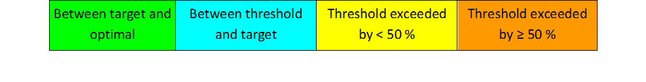
H-SAF PT Meeting
Validation H13 Snow Water Eq.
H13: operational Data from Poland, Finland, Turkey, Germany.
Validation 2019-20
Area | Threshold | Target | Optimal
flat (RMSE) | 40 mm | 20 mm | 10 mm
mountain (RMSE) | 45 mm | 25 mm | 15 mm
H-SAF Accuracy requirements for H13
Product requirements |  |  |  | RMSE (mm)
 | threshold | target | optimal | AVERAGE | Poland | Finland | Turkey | Germany
N. samples |  |  |  |  | 441 | 597 | 2848 | 1637
Mountainous | 45 mm | 25 mm | 15 mm | 39.2 mm |  |  | 39.2 mm
Flat Area | 40 mm | 20 mm | 10 mm | 23.5 mm | 9.5 mm | 36.7 mm |  | 24.2 mm

Slide 17
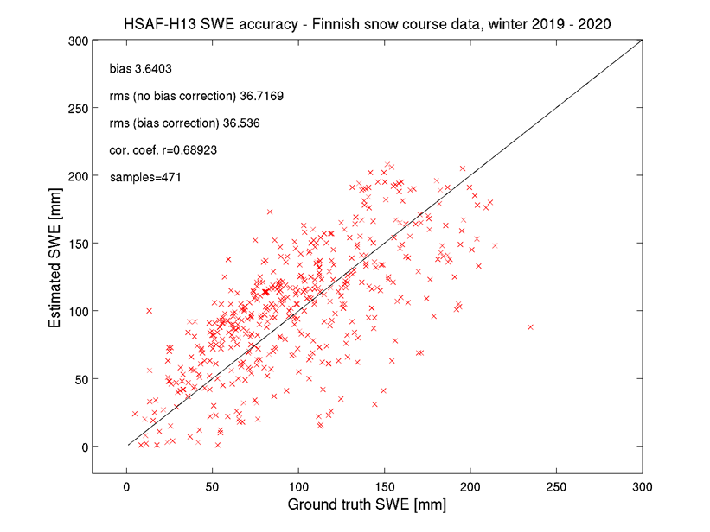
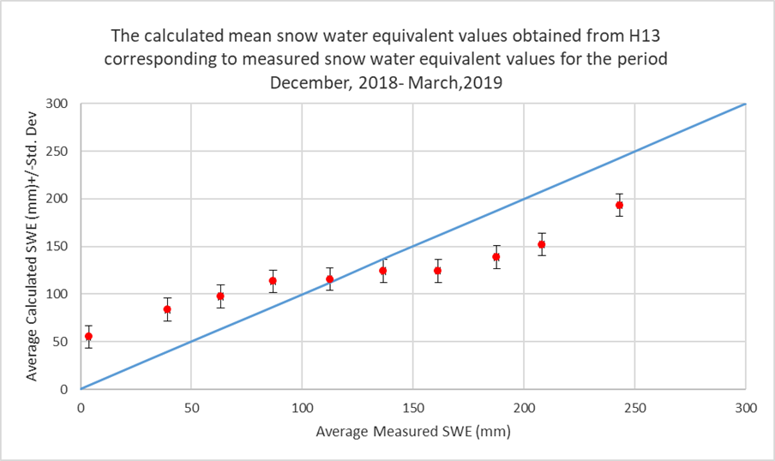
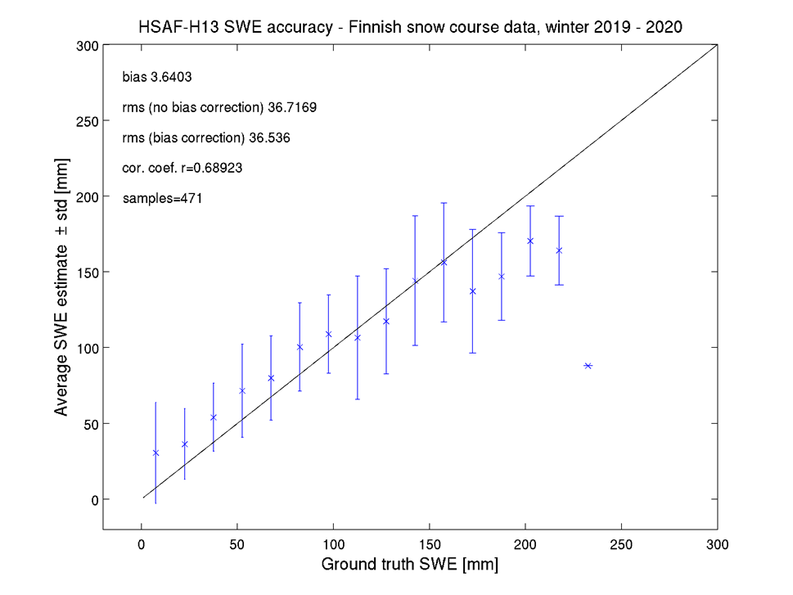
H-SAF PT Meeting
Validation H13 details
Detail over Finland and Turkey
General underestimation of SWE when values are larger than 150 mm.

Slide 18
H-SAF PT Meeting
Validation H13 discussion
H13 satisfies the Product Requirements, with RMSE between threshold and target values.
Since the SWE product is developed for dry snow conditions, validation period is selected as December to March (or to April for Germany), only in Finland, where snow cover is more stable, the whole period October-May is evaluated.
Best performance are obtained in flat areas.
Turkish and Finnish studies: general underestimation of SWE when values are larger than 150 mm, slight overestimate below

Slide 19
H-SAF PT Meeting
RECAP
Snow Detection Products (Snow Cover) H10, H34, H32
Best performances in flat areas, were snow cover is more homogeneous
Problems arise if non homogeneous snow cover (space and time)
Validation with ground data very difficult (filtering needed). Better performances with high resolution satellite data
Snow Status (Dry/Wet) H11: Validation suggest use only in Nordic areas (flat). Validation difficult if not impossible due to proxi data (temperature)
Fractional/Effective Snow Cover H12 and H35: Validation results good in flat areas, acceptable in mountainous areas, due to problems of resolution (complex terrain) and not homogeneous snow cover in mountains
SWE Products H13: Performances better in flat areas (RMSE 10-20 mm), in mountainous areas ( around 40 mm). Underestimate if more than 100 cm snow.

Slide 20
H-SAF PT Meeting
Thank You!

